Slide 1
CHRONIC OBSTRUCTIVE PULMONARY
DISEASE
Dr. R. Bindhusaran, Associate professor
DEPT OF PATHOLOGY, SKHMC, Kulasekharam

Slide 2
Definition
Chronic obstructive pulmonary disease (COPD) are a group of pathological conditions in which there is chronic, partial or complete, obstruction to the airﬂow at any level from trachea to the smallest airways resulting in functional disability of the lungs.
One etiologic factor which is a common denominator in all forms of COPD is smoking.

Slide 3
CONDITIONS
I. Chronic bronchitis
II. Emphysema
III. Bronchial asthma
IV. Bronchiectasis
V. Small airways disease (bronchiolitis)

Slide 4
CHRONIC BRONCHITIS
Chronic bronchitis is defined clinically as persistent cough with expectoration on most days for at least three months of the year for two or more consecutive years.
The cough is caused by over secretion of mucus
The condition is more common in middle-aged males than females.

Slide 5
ETIOPATHOGENESIS
Smoking
Heavy cigarette smokers have 4 to 10 times higher proneness to develop chronic bronchitis. Prolonged cigarette smoking appears to act on the lungs in a number of ways:
i) It impairs ciliary movement.
ii) It inhibits the function of alveolar macrophages.
iii) It leads to hypertrophy and hyperplasia of mucus-secreting glands.
iv) It causes considerable obstruction of small airways.
v) It stimulates the vagus and causes bronchoconstriction

Slide 6
2. Atmospheric pollution
sulfur dioxide, nitrogen dioxide, particulate dust and toxic fumes.
3. Occupation
Workers engaged in certain occupations such as in cotton mills (byssinosis), plastic factories etc.

Slide 7
5. Familial and genetic factors
It is more likely that nonsmoker family members who remain in the air-pollution of home are signifcantly exposed to smoke (passive smoking) and hence have increased blood levels of carbon monoxide.

Slide 8
MORPHOLOGIC FEATURES
Grossly,
Bronchial wall is thickened, hyperaemic and oedematous.
Lumina of the bronchi and bronchioles may contain mucus plugs and purulent exudate.
Microscopically,
Increased Reid index.
Reid index is the ratio between thickness of the submucosal mucus glands (i.e. hypertrophy and hyperplasia) in the cartilage-containing large airways to that of the total bronchial wall
The bronchial epithelium may show squamous metaplasia and dysplasia.
There is little chronic inﬂammatory cell infiltrate.
The non-cartilage containing small airways show goblet cell hyperplasia and intra luminal and peri bronchial fibrosis.

Slide 9
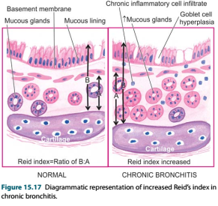

Slide 10
CLINICAL FEATURES
There is considerable overlap of clinical features of chronic bronchitis and pulmonary emphysema (discussed below) as quite often the two coexist.
Some important features of ‘predominant bronchitis’ are as under:
1. Persistent cough with copious expectoration of long duration; initially beginning in a heavy smoker with ‘morning catarrh’ or ‘throat clearing’ which worsens in winter.
2. Recurrent respiratory infections are common.

Slide 11
3. Dyspnoea is generally not prominent at rest but is more on exertion.
4. Patients are called ‘blue bloaters’ due to cyanosis and oedema.
5. Features of right heart failure (cor pulmonale) are common.
6. Chest X-ray shows enlarged heart with prominent vessels

Slide 12
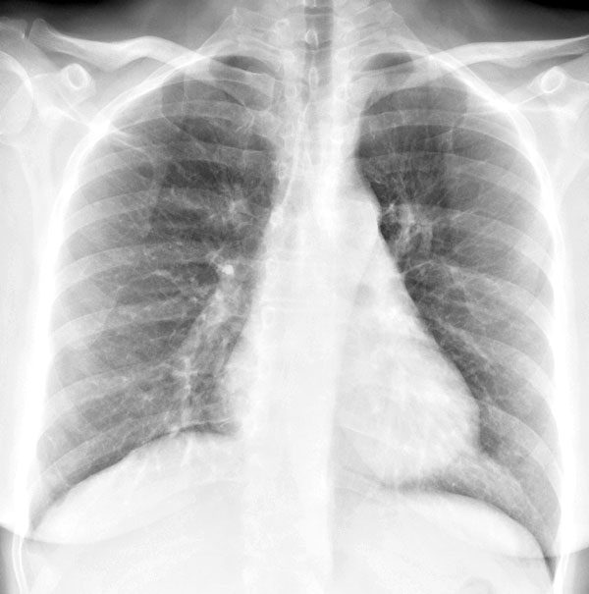
CXR chronic bronchitis

Slide 13
EMPHYSEMA
A combination of permanent dilatation of air spaces distal to the terminal bronchioles and the destruction of the walls of dilated air spaces.
Thus, emphysema and chronic bronchitis shows considerable overlap in their clinical features, it is usual to label patients as ‘predominant emphysema’ and ‘predominant bronchitis’

Slide 14
CLASSIFICATION
As per WHO defnition of pulmonary emphysema, it is classifed according to the portion of the acinus involved, into 5 types:
Centri Acinar,
Panacinar (Panlobular),
Para-septal (Distal Acinar),
Irregular (Paracicatricial)
And Mixed (Unclassifed) Emphysema.

Slide 15
A. TRUE EMPHYSEMA
1. Centriacinar (centrilobular) emphysema
2. Panacinar (panlobular) emphysema
3. Paraseptal (distal acinar) emphysema
4. Irregular (para-cicatricial) emphysema
5. Mixed (unclassifed) emphysema
B. OVERINFLATION
1. Compensatory overinﬂation (compensatory emphysema)
2. Senile hyperinﬂation (ageing lung, senile emphysema)
3. Obstructive overinﬂation (infantile lobar emphysema)
4. Unilateral translucent lung (unilateral emphysema)
5. Interstitial emphysema (surgical emphysema)

Slide 16
ETIOPATHOGENESIS
The commonest form of COPD is the combination of chronic bronchitis and pulmonary emphysema.
The association of the two condition is principally linked to the common etiologic factors—most importantly tobacco smoke and air pollutants.

Slide 17
PATHOGENESIS
Most significant event in emphysema, the destruction of the alveolar walls, is related to defciency of serum α-1-antitrypsin
Protease-antiprotease hypothesis
α -1-antitrypsin (α -1-AT), also called α 1-protease inhibitor
codes for α -1-AT is located on the long arm of chromosome 15.
It is normally synthesised in the liver and is distributed in the circulating blood, tissue ﬂuids and macrophages.
The normal function of α 1-AT is to inhibit proteases and hence its name α 1-protease inhibitor

Slide 18
Neutrophil elastase has the capability of digesting lung parenchyma but is inhibited from doing so by anti-elastase eﬀect of α1-AT
The α1-AT deficiency develops in adults and causes
pulmonary emphysema in smokers as well as in non-smokers

Slide 19
The mechanism of alveolar wall destruction in emphysema by elastolytic action is based on the imbalance between proteases (chieﬂy elastase) and anti-proteases (chieﬂy antielastase)
i) By decreased anti-elastase activity i.e. defciency of α-1 antitrypsin.
ii) By increased activity of elastase i.e. increased neutrophilic infiltration in the lungs causing excessive release of neutrophil elastase.

Slide 20
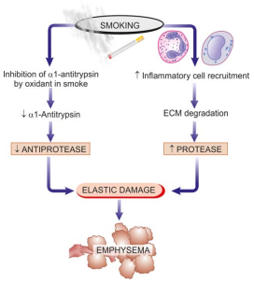

Slide 21
PATHOLOGIC FEATURES
Grossly
lungs are voluminous, pale with little blood.
The edges of the lungs are rounded.
Mild cases show dilatation of air spaces visible with hand lens. Advanced cases show subpleural bullae and blebs bulging outwards from the surface of the lungs with rib markings between them.
The bullae are air-flled cyst-like or bubble-like structure

Slide 22
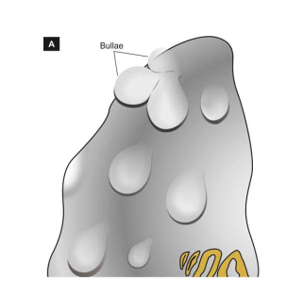

Slide 23
Microscopically
Dilatation of air spaces and destruction of septa walls of part of acinus involved i.e. respiratory bronchioles alveolar ducts and alveolar sacs.
Changes of bronchitis may be present.
Bullae and blebs when present show fibrosis and chronic inﬂammation of the walls

Slide 24
CLINICAL FEATURE
The age at the time of diagnosis is often a decade later (about 60 years) than the age for predominant bronchitis (about 50 years)
1. There is long history of slowly increasing severe exertional dyspnoea.
2. Patient is quite distressed with obvious use of accessory muscles of respiration.
3. Chest is barrel-shaped and hyperresonant.

Slide 25
4. Cough occurs late after dyspnoea starts and is associated with scanty mucoid sputum.
6. Patients are called ‘pink puﬀers’ as they remain well
oxygenated and have tachypnoea.
7. Weight loss is common.
8. Features of right heart failure (cor pulmonale) and
hypercapneic respiratory failure are the usual terminal events.
9. Chest X-ray shows small heart with hyperinﬂated lungs.

Slide 26
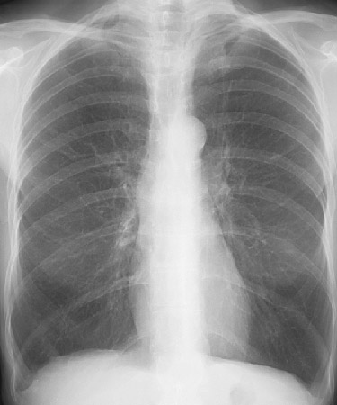
Emphysema

Slide 27
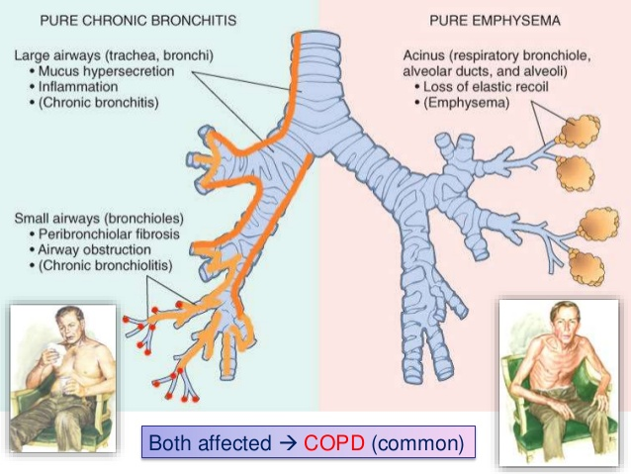

Slide 28


Slide 29
BRONCHIECTASIS
Bronchiectasis is defined as abnormal and irreversible dilatation of the bronchi and bronchioles (greater than 2 mm in diameter) developing secondary to inﬂammatory weakening of the bronchial walls.
The most characteristic clinical manifestation of bronchiectasis is persistent cough with expectoration of copious amounts of foul-smelling, purulent sputum.

Slide 30
ETIOPATHOGENESIS
two basic mechanisms: endobronchial obstruction and infection.
Endobronchial obstruction by foreign body, neoplastic growth or enlarged lymph nodes causes resorption of air distal to the obstruction with consequent atelectasis and retention of secretions

Slide 31
Infection may be secondary to local obstruction and
impaired systemic defense mechanism promoting bacterial growth,
or infection may be a primary event i.e. bronchiectasis developing in suppurative necrotising pneumonia

Slide 32
PATHOGENESIS
Endobronchial obstruction and infection, are seen in
1. Hereditary and congenital factors
i) Congenital bronchiectasis
ii) Cystic fibrosis
iii) Hereditary immune deficiency diseases
iv) Immotile cilia syndrome
v) Atopic bronchial asthma

Slide 33
2. Obstruction
foreign bodies, endobronchial tumours, compression by enlarged hilar lymph nodes and post-inﬂammatory scarring (e.g. in healed tuberculosis) all of which favour the development of postobstructive bronchiectasis.
3. As secondary complication
Necrotising pneumonias such as in staphylococcal suppurative pneumonia and tuberculosis may develop bronchiectasis as a complication.

Slide 34
MORPHOLOGIC FEATURES
The disease characteristically aﬀects distal bronchi and bronchioles beyond the segmental bronchi.
Grossly
The lungs may be involved diﬀusely or segmentally.
Bilateral involvement of lower lobes occurs most frequently.
The pleura is usually fbrotic and thickened with adhesions to the chest wall.

Slide 35
The dilated airways, subclassifed into the following diﬀerent types
i) Cylindrical: the most common type characterised by
tube-like bronchial dilatation.
ii) Fusiform: having spindle-shaped bronchial dilatation.
iii) Saccular: having rounded sac-like bronchial distension.
iv) Varicose: having irregular bronchial enlargements.

Slide 36
Cut surface of the aﬀected lobes, generally the lower zones, shows characteristic honey-combed appearance.
The bronchi are extensively dilated nearly to the pleura, their walls are thickened and the lumina are filled with mucus or mucopus.
The intervening lung parenchyma is reduced and fibrotic

Slide 37
Microscopically
Fully-developed cases show the following
histologic features
i) The bronchial epithelium may be normal, ulcerated o may show squamous metaplasia.
ii) The bronchial wall shows infiltration by acute and
chronic inﬂammatory cells and destruction of normal
muscle and elastic tissue with replacement by fibrosis
iii) The intervening lung parenchyma shows fibrosis, while the surrounding lung tissue shows changes of interstitial pneumonia

Slide 38
CLINICAL FEATURES
The clinical manifestations of
bronchiectasis typically consist of chronic cough with foul smelling sputum production, haemoptysis and recurrent pneumonia.
Sinusitis is a common accompaniment of
diﬀuse bronchiectasis.
Late complications occurring in cases uncontrolled for years include development of clubbing of the fingers, metastatic abscesses (often to the brain), amyloidosis
and cor pulmonale

Slide 39
Reference
Harsh Mohan Text Book of Pathology
Robbins & Cotran Pathologic Basis of Disease,

